Slide 1

Ethics & communication project
3.8 Autonomous warfare - are there ever situations where it could be condoned?
Andrew Smith
CodeClan - D4

Slide 2
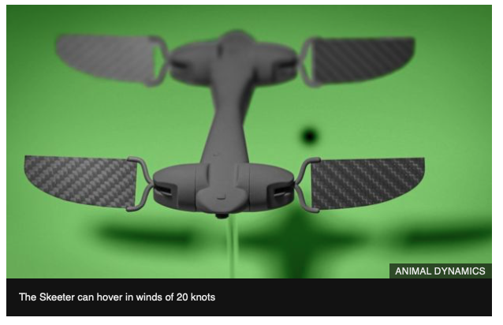
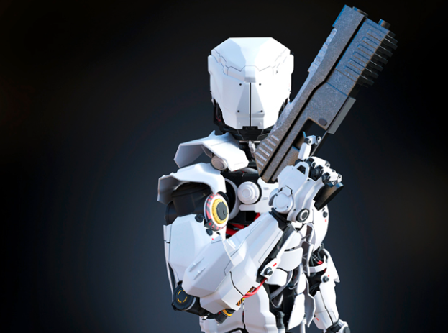
3.8 Autonomous warfare - are there ever situations where it could be condoned?
1. Topic summary
“This era is not decades away. It’s not even years away. Killer robots are moments away from making their grand entrance.”
Abishur Prakash, ‘The age of killer robots’
“Letting machines decide over life and death of human beings runs against all of our ethical standards”.
German Government
Known as : Lethal autonomous weapons (LAWs) are a type of autonomous military system that can independently search for and engage targets based on programmed constraints and descriptions. ... LAWs may operate in the air, on land, on water, under water, or in space.
Notes:
Autonomous weapons have been described as the third revolution in warfare, after gunpowder and nuclear arms.
They are devices that can identify, track and attack a target without human intervention. It may take the form of a drone, a gun, or a robot that may or may not have a humanoid form. The key element of an autonomous weapon is that once activated – switched on – it makes the decision itself about whether to attack a target, which may or may not be a human.
Modern military powers all currently have and continue to develop the use of Artificial Intelligence for both offensive and defensive purposes, be it for use in vehicles logistics, for surveillance and or weaponry. The world’s military are already utilising the technology for vehicles - none so far are truly autonomous.
Concern is over the use of fully autonomous weapons, also known as "killer robots," which would be able to select and engage targets without meaningful human control. SO while dozens of nations are or will be investing in killer robots, only a handful of countries are developing them.
While companies such as Amazon are looking to develop package delivery drones - described as killer robots in waiting. Developers of these drone systems are building systems for good, however one person’s package delivery drone is another person’s autonomous weapons system.

Slide 3

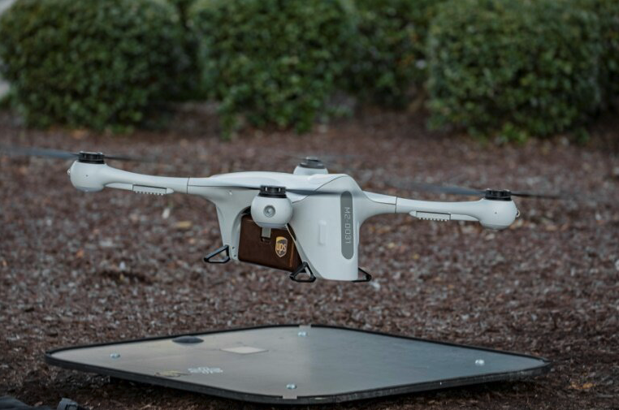
3.8 Autonomous warfare - are there ever situations where it could be condoned?
2. Challenges and ambiguities
“A.I. technologies cannot capture human judgement and ethical rules that are essentially making decisions concerning life and death.”
Prof. Carla Gomes, Computer Science, Cornell University
One person’s package delivery drone is another person’s autonomous weapons system.
AI systems today are still merely simplistic correlation engines, representing their worlds as naive primitive assemblies of colors and textures. Kalev Leetaru, Forbes
Notes:
Challenges
Fully autonomous weapons would decide who lives and dies, without further human intervention As machines, they would lack the inherently human characteristics such as compassion that are necessary to make complex ethical choices.
What happens when an AI-powered military system malfunctions? A weapon needs to be correct 100% of the time, everytime.
An AI-powered weapon does not recognize a target as a specific individual, vehicle or structure, but rather as a unique set of colors and textures in a specific relationship to each other.
This makes such weapons uniquely vulnerable to subtle modifications that can mask their targets or even cause them to attack unrelated targets.
It creates/ or potential could exploit a ‘grey’ area in Law - if an incident were to happen - or a ‘when’ a AI military system malfunctions - who would be to blame? Could a country claim it as an accident?
Unlike nuclear, biological or chemical weapons, lethal autonomous weapon can be built easily with easy to be found materials and they are more easy to be hacked or fall into the wrong hands.
Q. How hard is it for any system to distinguish between combatants and non-combatants? Could a country go to war because of an algorithm?
Have the people who built the algorithm robust, full proof, without bias, is it more objective?
Who would would govern, monitor and oversee. Can a human override the decisions? Who says something is right and another thing is wrong?
Can an algorithm make a nuance decision and come to the same ethical decision?
An example Paul Scharre Army of None: Autonomous Weapons and the Future of War - describes an incident in which he and some fellow soldiers, while in Afghanistan. They could hear a young girl closeby talking on a radio—a clear indication she was scouting their position for a Taliban force hiding nearby. Under the rules of war, Scharre explains, the young girl was an enemy combatant, putting his unit at risk, and so could have been shot. Yet, he chose not to, acting out of an innate moral impulse. “My fellow soldiers and I knew killing her would be morally wrong. We didn’t even discuss it.” Could machines ever be trained to make this distinction? Scharre is highly doubtful.

Slide 4
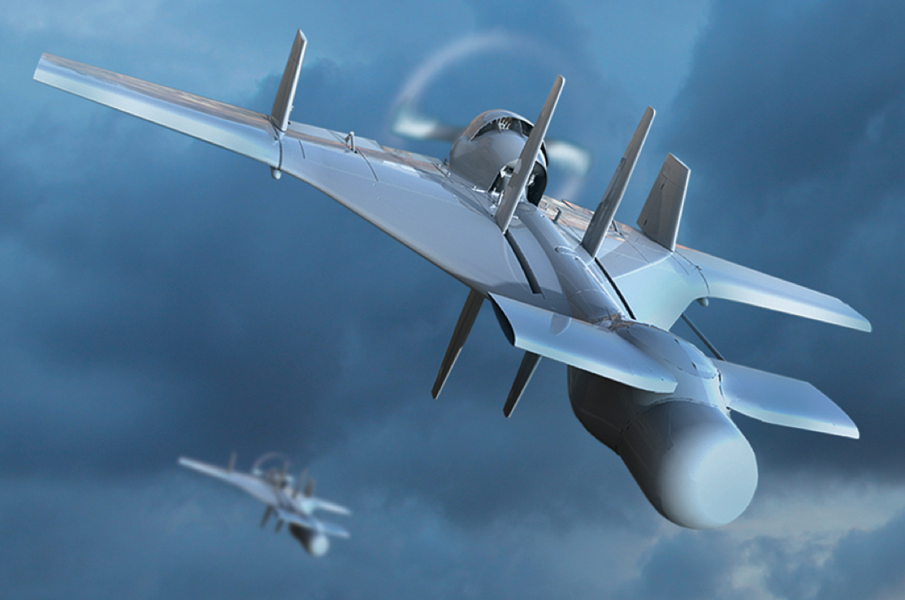
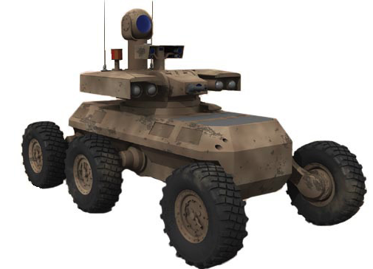
3.8 Autonomous warfare - are there ever situations where it could be condoned?
3. Potential solutions
3 Options:
Total ban of fully autonomous weapon systems
Regulating the use of fully autonomous weapon systems
Continue and leave for open development
Routes to resolution
1. Legally through the UN
2. Moral agreement. AI experts refusing to work on LAW projects
Campaigns to Ban Lethal Autonomous
Future of Life Institute (FLI) - Elon Musk
Stop Killer Robots
Ban Autonomous Weapons
Notes:
The solution, approach or way forward?
2 routes -
i) Legally through the UN
ii) Moral agreement with AI experts refusing to work on LAW projects
November 2019 was the 4th meeting of member countries of the United Nations Convention on Conventional Weapons (CCW) in Geneva,
CCW - provides a range of possibilities for controlling weapons use, either banning systems in advance or accepting their inevitability but proscribing their use in certain scenarios,
Addressing legal, technical, security and ethical concerns relating to the use of LAWS, including the implications for international humanitarian law and international human rights law.
Diplomats still cannot not agree on a binding common approach - still talking on non-binding talks instead of concrete legal work
Over 30 governments are demanding a ban on artificial intelligence weapons, while both the US and Russia have blocked any moves to form legally binding agreements on autonomous weaponry.
U.N. has to be the organisation that implements a ban - and become codified in a UN Treaty under international law - the UN Security Council is the only international body where this would have legitimate power and enforce consequences.
The challenge as above is will have to ratified by all member states
As Treaty talks have stalled a different approach is being taken -
Worldwide there are a number of campaigns to ban lethal autonomous weapons from A.I. experts against fully Autonomous Warfare.
In July 2015, experts in artificial intelligence signed a letter warning of the threat of an artificial intelligence arms race and calling for a ban on autonomous weapons.
TO DATE 4,502 AI/Robotics researchers and 26,215 others have signed the letter. Including Stephen Hawking, Elon Musk, Steve Wozniak

Slide 5


3.8 Autonomous warfare - are there ever situations where it could be condoned?
4. Opinion and recommendation
Self policing by Individuals, companies or countries of their own code of conduct/ licensing (governed by their own moral code) - insufficient as it will almost certainly be ignored at some level.
UN - an agreement has to be codified in a Treaty and enforceable!
Until then - sign the petition!
Notes:
Key
Firstly - AI to a lesser or greater extent will be used by military forces.
However fully LAW.s must have meaningful human control over targeting and attack decisions by prohibiting development, production, and use of fully autonomous weapons has to be retained- where will the line of control drawn?
I believe the best way is to - A legally binding instrument governing the use of fully autonomous weapons - to establish the principle of meaningful human control over the use of force.
While - Progress toward an appropriate multilateral solution, has been slow. If countries do not shift soon from abstract talk to treaty negotiations, the development of technology will outpace international diplomacy.
While Experts to sign up is fantastic - will it stop rogue entities - unlikely but it is help get the issue noticed and bring pressure to governments.
My recommendation?
‘One person’s package delivery drone is another person’s autonomous weapons system.’
It’s challenging - rogue states and countries such as China do not share the same ethical and moral standards as Western Countries.
So while I am ever the optimist countries will sign up to a Treaty - I am sceptical all rogues entities or countries will actually stop development and a challenge to enforce.

Slide 6
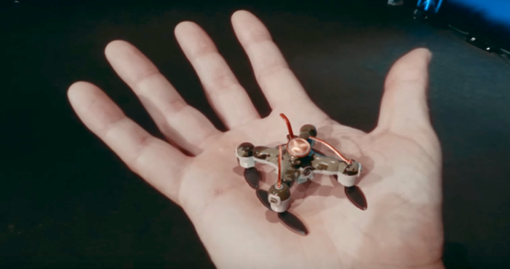
3.8 Autonomous warfare - are there ever situations where it could be condoned?
Appendix
Link to the Future of Life Institute open letter - which can be signed.
https://futureoflife.org/open-letter-autonomous-weapons/
Stop Killer Robots
https://www.stopkillerrobots.org
Slaughter Bots - Stop Autonomous Weapons
https://www.youtube.com/watch?v=9CO6M2HsoIA
Why We Should Ban Lethal Autonomous Weapons - Future of Life Institute
https://www.youtube.com/watch?v=LVwD-IZosJE

